Slide 1
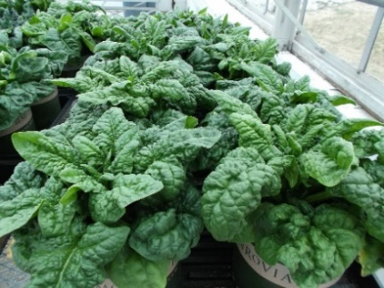
Genome-Wide Association Study and Genomic Prediction of Oxalate Content in Spinach
Haizheng Xiong¹, Ainong Shi¹ and Beiquan Mou²
(1)University of Arkansas, (2)USDA-ARS
2023 ASHS Conference

Slide 2
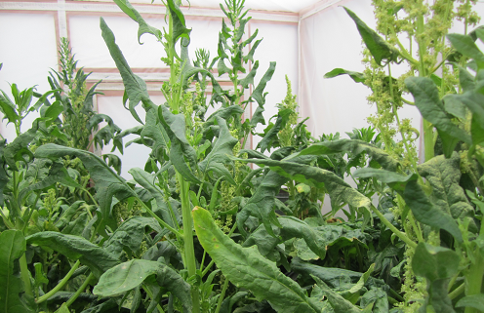

Objective
To identify single nucleotide polymorphism markers associated with oxalate content through genome-wide association study
To estimate the prediction accuracy of genomic prediction for selecting spinach lines with low-oxalate content

Slide 3
Materials and Methods
Plant materials: 310 spinach genotypes
Experiment design: RCBD; 2-rep
Experiment: Eight seeds from each genotype were planted in a plastic pot (10 x 10 x 10 cm) filled with field soil in the greenhouse. Five weeks after planting, all leaves in a pot were harvested without petioles in the morning and fresh weight of the leaves was determined.
Measurement: The oxalate concentration was determined using an oxalate kit (Procedure No. 591; Trinity Biotech, St. Louis) (Palaniswamy et al., 2004).

Slide 4
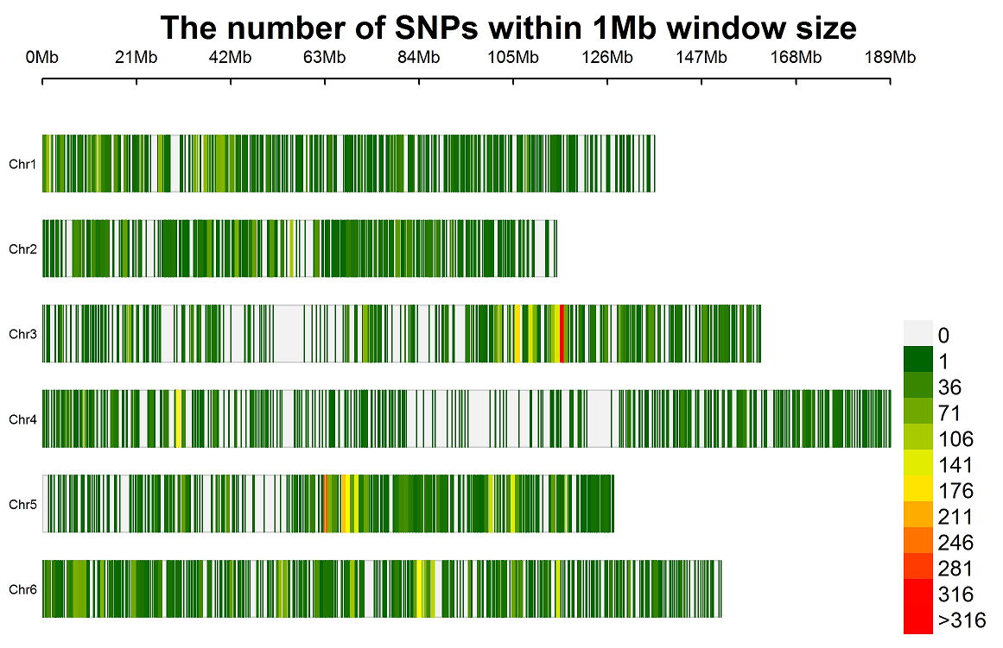
Materials and Methods
Genotyping
Sequencing: using whole genome resequencing (WGR) by Illumina HiSeq platform at BGI.
SNP discovery: 10Gb from WGR were obtained in each spinach line; >10 million SNPs have been found through WGR in spinach
SNP set: 14,286 SNPs distributed on 6 chromosomes were used to perform GWAS after filtered and keeping MAF>5%, Missing < 8%, and Het < 15%
SNP Distribution on Six Chromosomes

Slide 5
Materials & Methods
Genome-wide Association Study
and Genomic Prediction
GWAS:
GLM and MLM in TASSEL 5 (Bradbury et al., 2007)
BLINK, FarmCPU, GLM, MLM, and MLMM in GAPIT 3 (Huang & Zheng 2018)
GP:
rr-BLUP (Endelman 2011)
gBLUP and cBLUP in GAPIT 3 (Wang and Zhang, 2021)
Bayes A (BA), Bayes B (BB), Bayes LASSO (BL), and Bayes ridge regression (BRR) implemented in BGLR package (Legarra et al., 2011; Barili et al., 2018).
5-fold cross-validation sets (training: testing = 4:1) were used to estimate prediction accuracy, with r-value calculated over 100 runs

Slide 6
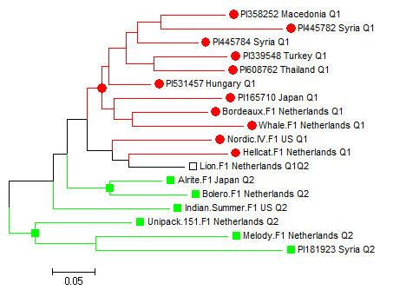
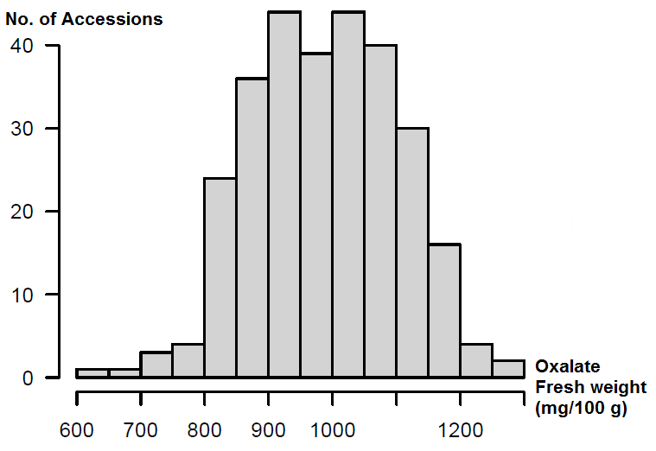
RESULTS
Distribution of oxalate fresh weight in 286 spinach accessions
Phylogenetic tree among 18 spinach accessions with low oxalate content

Slide 7
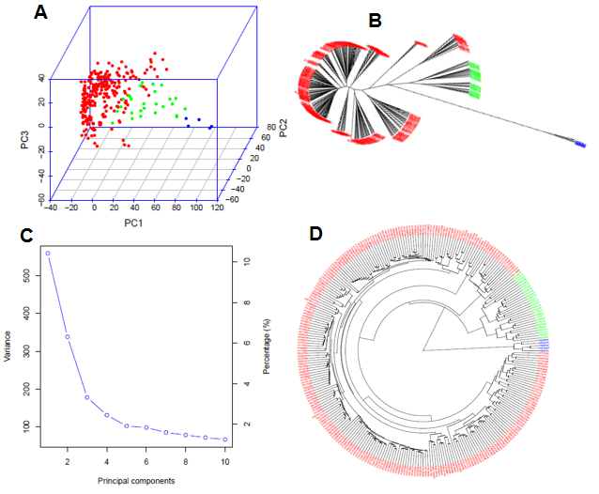
Result
Genetic Diversity and Population Structure
Three subpopulations divided
Population genetic diversity analysis in the association panel consisted of 286 USDA spinach germplasm accessions.
(A) 3D graphical plot of the principal component analysis (PCA),
(B & D) Phylogenetic trees (B – unrooted and D - fan) drawn by neighbor-joining (NJ) method in three sub-population, and
(C) PCA.eigenValue plot drawn by GAPIT 3.

Slide 8
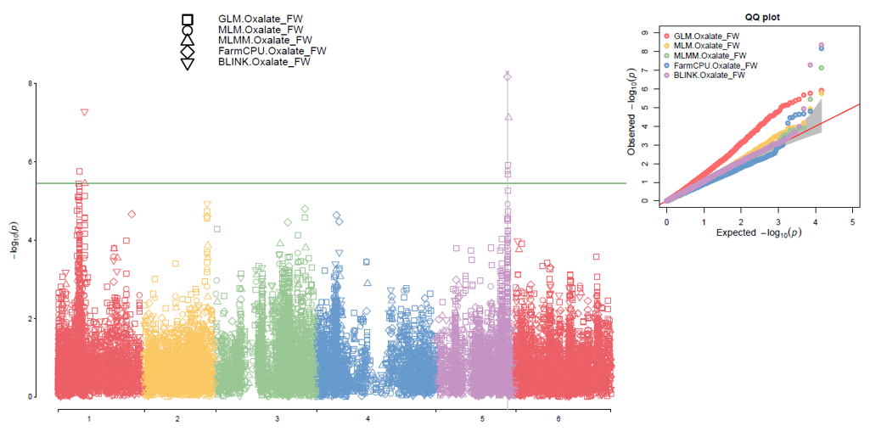
Result
GWAS for Low Oxalate Content
A major QTL at chr 5

Slide 9
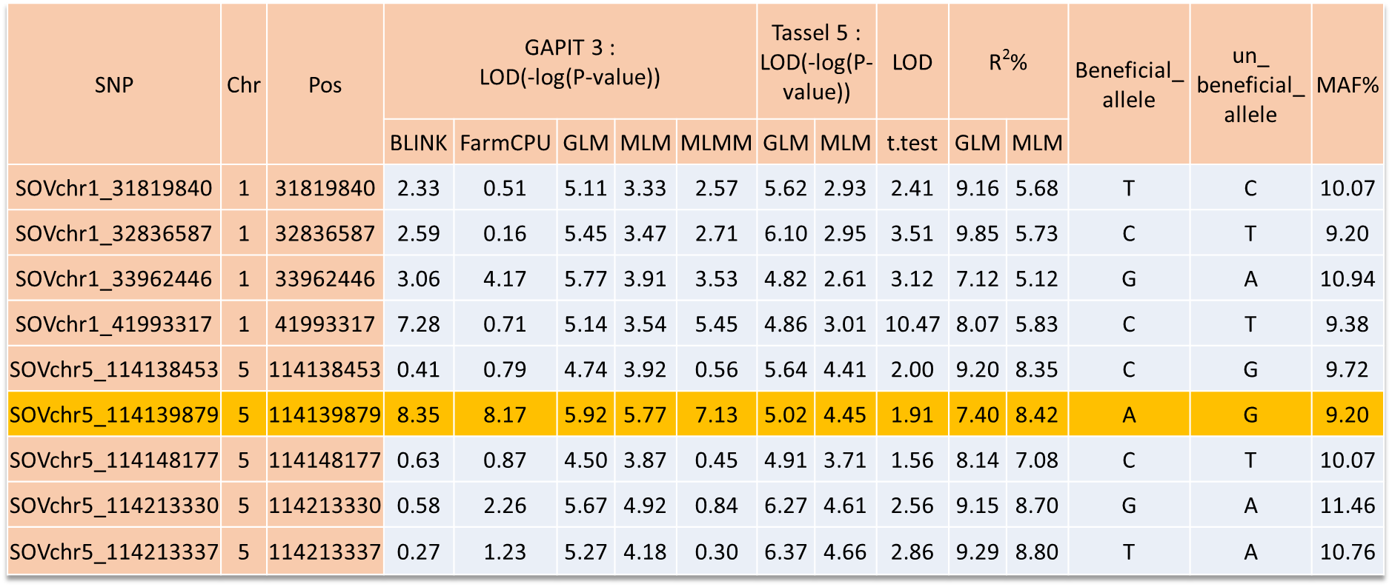
Result
SNP Markers for Low Oxalate Content

Slide 10
Result
Candidate Genes for Low Oxalate Content

Slide 11
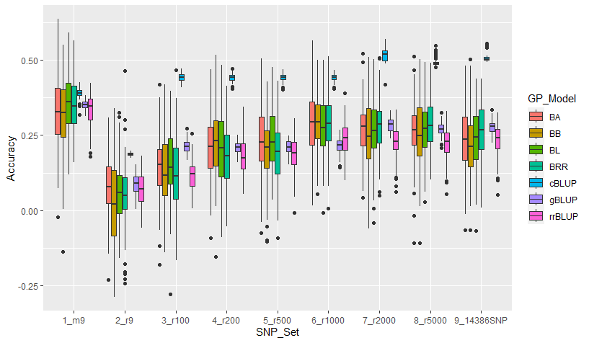
Genomic Prediction
Result
cBLUP showed highest
The set of 9 GWAS-derived SNP markers was high r values across all 7 models
r = 0.39 ( 9 GWAS-derived SNP markers)
r = 0.51 (14386 SNPs) in cBLUP
Genomic prediction (r-value) of ten different SNP number sets: (1) 9 GWAS-derived SNP markers, (2) - (8) 9 to 5000 SNP sets randomly selected 14,386 SNPs, and 14,386 SNPs in cross-prediction for oxalate content in 288 spinach accessions estimated by seven models: BA, BB, BL, BRR, cBLUP, gBLUP, and rrBLUP

Slide 12
SUMMARY
4-SNP on chr 1 and 5-SNP on chr 5 were associated with oxalate content
SOVchr5_114139879 on chr 5 is the best SNP marker
The prediction accuracy (PA) (averaged r-value) was 0.39 when using the 9 GWAS-derived significant SNP markers and 0.51 when using the 14386-SNPs as a set in the cBLUP.
The SNP markers and the genomic prediction (GP) provide useful information for breeders to select low-oxalate content in spinach breeding programs by marker-assisted selection (MAS) and genomic selection (GS).

Slide 13
