Slide 1
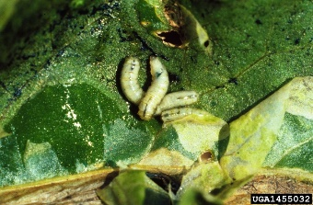
Genome-Wide Association Study and Genomic Prediction of Leafminer Tolerance in Spinach
Ibtisam Alatawi¹, Haizheng Xiong¹,
Gehendra Bhattarai¹, Beiquan Mou^{2,} and Ainong Shi¹
(1)University of Arkansas, (2)USDA-ARS
2023 ASA-CSSA-SSSA Conference

Slide 2
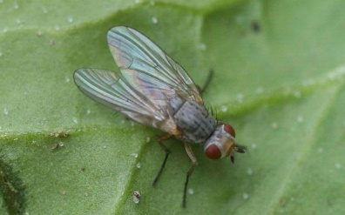
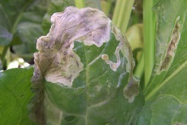
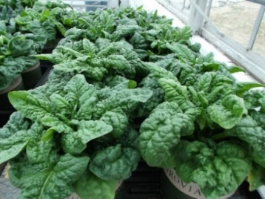
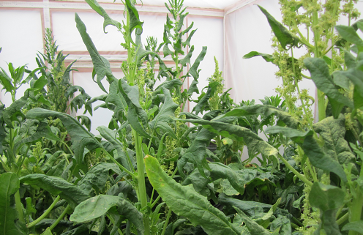
Objective
To identify SNP markers associated with leafminer tolerance through GWAS
To estimate the prediction accuracy of genomic prediction for selecting spinach lines with leafminer tolerance

Slide 3
Materials and Methods
Plant materials: 286 spinach genotypes
Experiment:
10 plants per pot.
Pots were put on an outdoor insect cage
~3500 leafminer flies in the cage were feed on the spinach plants.
The number of stings per unit area was counted on the leaf with most leafminer stings on each plant using an optical glass binocular magnifier (OptiVisor; Donegan Optical Co., Lenexa, Kans.).
For each spinach genotype, the stings per square centimeter was accounted based on a single plant and a total of 10 plants in one pot were evaluated. The mean stings per square centimeter for each spinach genotype was used for further data analysis.

Slide 4
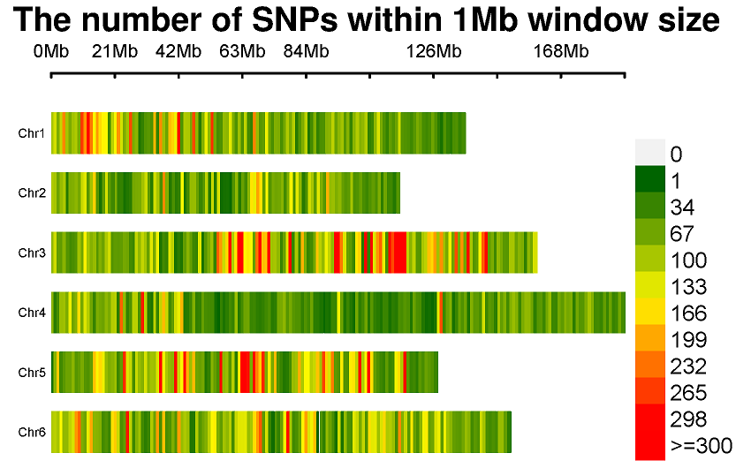
Materials and Methods
Genotyping
Sequencing: using whole genome resequencing (WGR) by Illumina HiSeq platform at BGI.
SNP discovery: 10Gb from WGR were obtained in each spinach line; >10 million SNPs have been found through WGR in spinach
SNP set: 84,301 SNPs distributed on 6 chromosomes were used to perform GWAS after filtered and keeping MAF>2%, Missing < 7%, and Het < 15%
SNP Distribution on Six Chromosomes

Slide 5
Materials & Methods
Genome-wide Association Study
and Genomic Prediction
GWAS:
GLM and MLM in TASSEL 5 (Bradbury et al., 2007)
BLINK, FarmCPU, GLM, MLM, and MLMM in GAPIT 3 (Huang & Zheng 2018)
GP:
rr-BLUP (Endelman 2011)
gBLUP and cBLUP in GAPIT 3 (Wang and Zhang, 2021)
Bayes A (BA), Bayes B (BB), Bayes LASSO (BL), and Bayes ridge regression (BRR) implemented in BGLR package (Legarra et al., 2011; Barili et al., 2018).
5-fold cross-validation sets (training: testing = 4:1) were used to estimate prediction accuracy, with r-value calculated over 100 runs

Slide 6
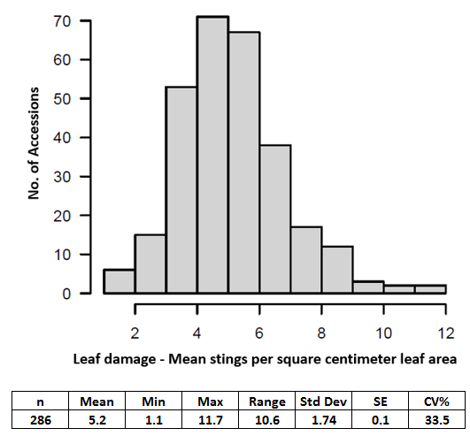
RESULTS

Slide 7
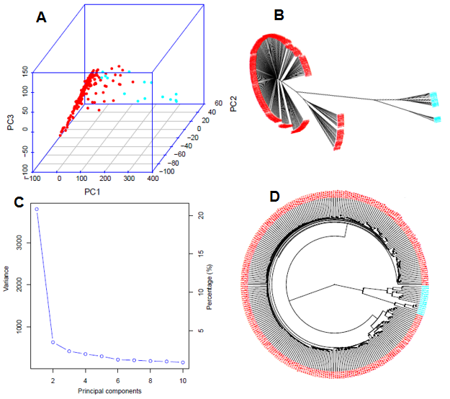
Result
Genetic Diversity and Population Structure
Two subpopulations divided
Population genetic diversity analysis in the association panel consisted of 286 USDA spinach germplasm accessions.
(A) 3D graphical plot of the principal component analysis (PCA),
(B & D) Phylogenetic trees (B - unrooted and D - fan) drawn by neighbor-joining (NJ) method in two sub-population, and (C) PCA.eigenValue plot drawn by GAPIT 3.

Slide 8
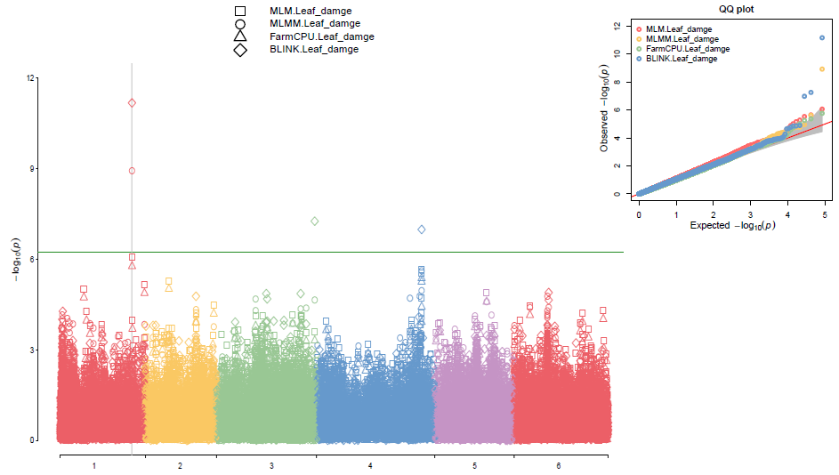
Result
GWAS for Leafminer Tolerance
The major QTL on Chr 1

Slide 9
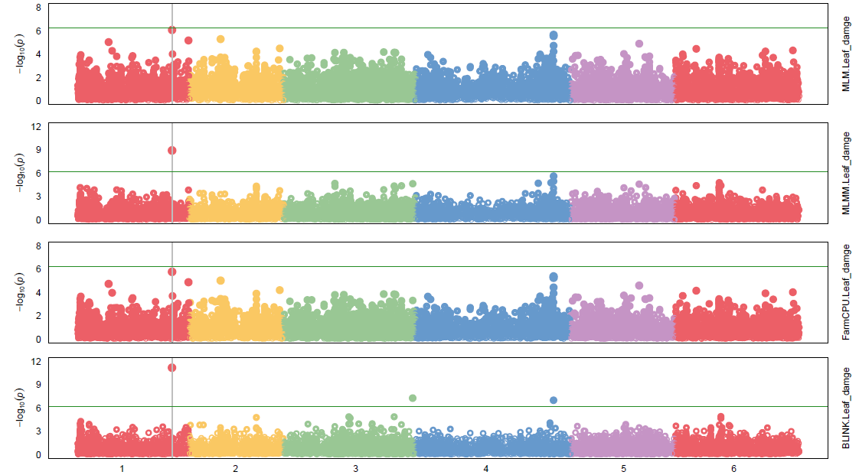
Result
GWAS for Leafminer Tolerance
The major QTL on Chr 1

Slide 10
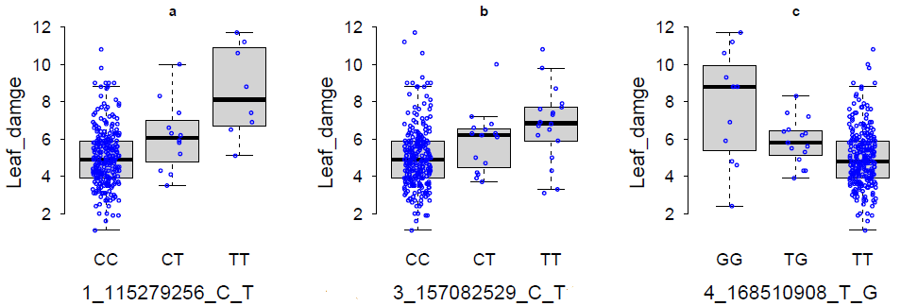
Result
SNP Markers for Leafminer Tolerance
SNP | Chr | Position (bp) | LOD [-log(P-value)] |  |  |  |  |  |  | LOD | MAF % | Lod>6.23
 |  |  | GAPIT 3 |  |  |  | TASSEL 5 |  |  | t-test
 |  |  | Blink | FarmCPU | MLM | MLMM | MLM | GLM | SMR
1_115279256_C_T | 1 | 115279256 | 11.18 | 5.77 | 6.07 | 8.93 | 4.70 | 6.27 | 7.59 | 4.48 | 7 | Blink,MLMM, t.GLM, t.SMR
3_157082529_C_T | 3 | 157082529 | 7.26 | 3.31 | 3.59 | 4.65 | 3.22 | 2.59 | 3.71 | 3.72 | 9.8 | Blink
4_168510908_T_G | 4 | 168510908 | 6.99 | 5.26 | 5.54 | 5.62 | 3.97 | 4.81 | 7.23 | 2.80 | 7.5 | Blink,t.SMR

Slide 11
Result
Candidate Genes for Leafminer Tolerance

Slide 12
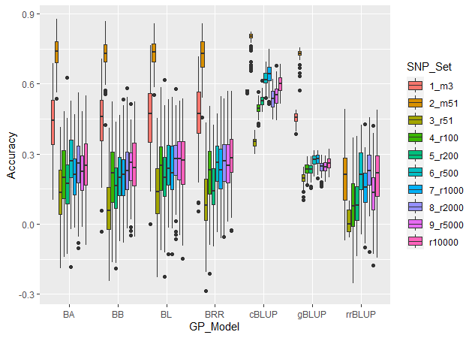

Genomic Prediction
Result

Slide 13
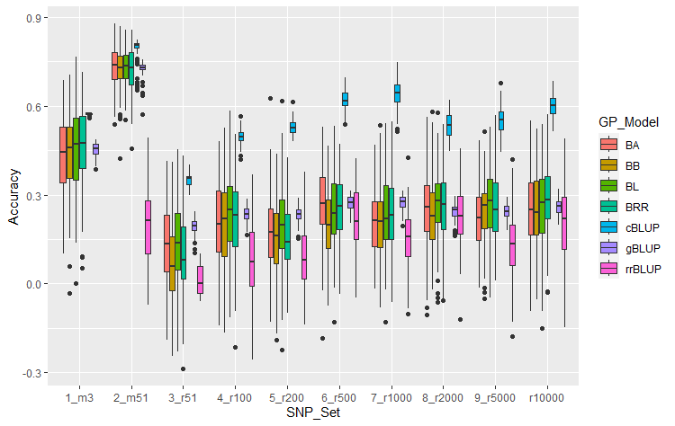
Genomic Prediction
Result
R-value was 0.25 after using 500 or more SNPs
The set of 51 GWAS-derived SNP markers (m51) was high r values across all 7 models ( r > 0.65)
Even 3 SNP marker set had high r-value (r > 0.42)
r = 0.79 (m51) in cBLUP

Slide 14
SUMMARY
Three SNP markers, 1_115279256 on chromosome (chr) 1, 3_157082529 on chr 3, and 4_168510908 on chr 4 were associated with leaf damage (mean stings per square centimeter leaf area)
Prediction accuracy (PA) can be close to 0.25 after using 500 or more SNPs
Using GWAS-derived SNP markers would increase PA with a high r-value up to 0.57 and 0.79 by 3 and 51 associated SNP markers in cBLUP
The SNP markers and the PA can be used in spinach breeding programs to select leafminer tolerance by marker-assisted selection (MAS) and genomic selection (GS).

Slide 15
