Slide 1
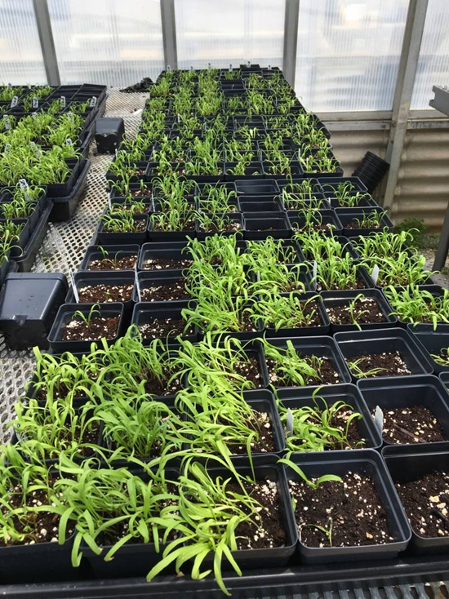
Evaluation and development of genomic tools for breeding Pythium-resistant spinach varieties in both conventional
and controlled environment agriculture
Gehendra Bhattarai, Bo Liu, Haizheng Xiong,
James Correll, Ainong Shi
University of Arkansas
2023 ASHS Conference

Slide 2
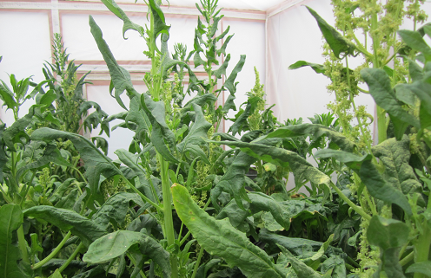
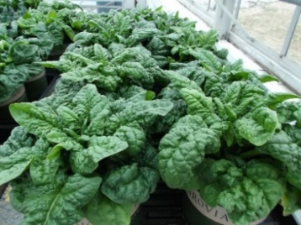
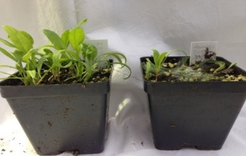
Objective
Evaluate and screen spinach germplasm for Pythium tolerance;
Conduct genome-wide association study to identify SNP markers associated with Pythium tolerance; and
Perform genomic prediction for Pythium tolerance in spinach.
R

Slide 3
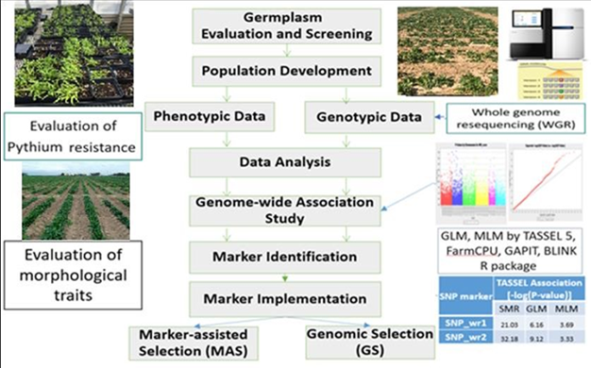

Slide 4
Materials and Methods
Plant materials: 377 spinach genotypes
Experiment design: RCBD; 3-rep
Damping-off test:
  Seed were planted in infested soil (10 PDA plugs, 3 days old) + 20 seeds.
  Infected soils with Pythium inoculum using sand corn meal agar
  20 seeds planted
  Count germination rates at 9 to 11 days

Slide 5
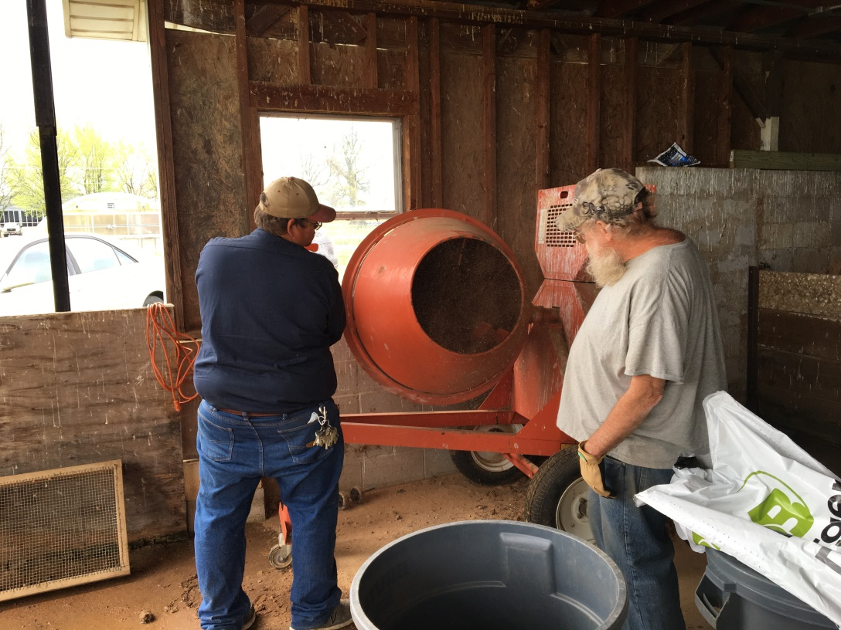
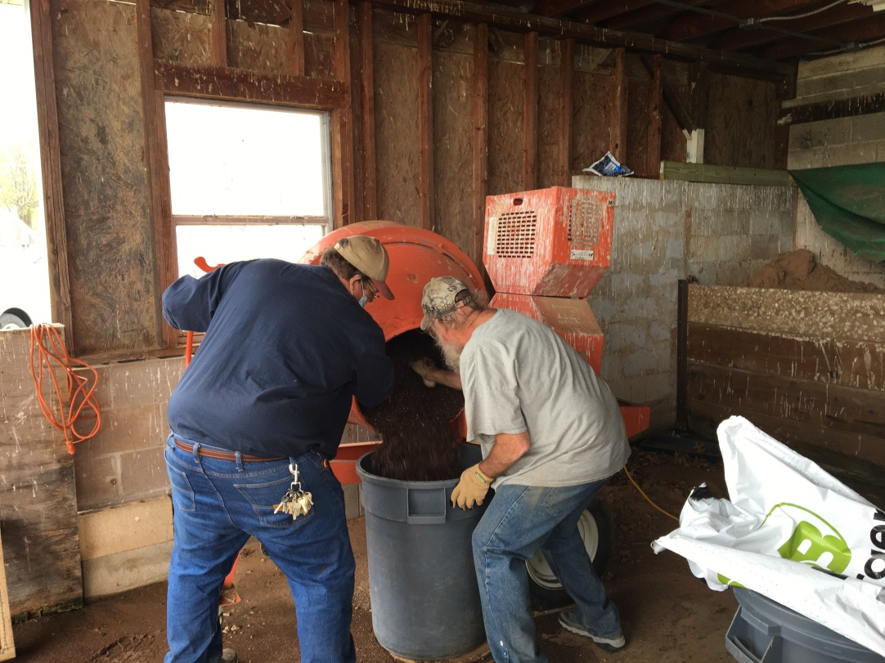
Inoculum preparation:
Mixing inoculum with soil

Slide 6
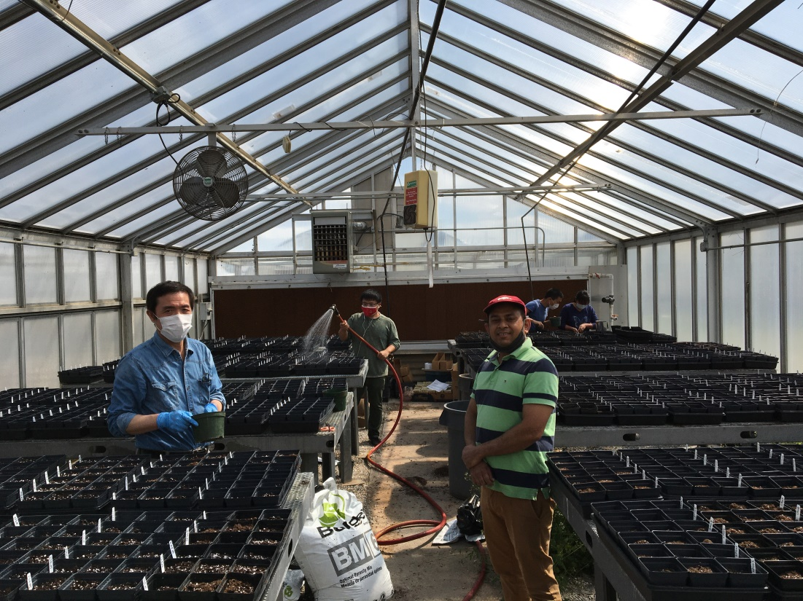
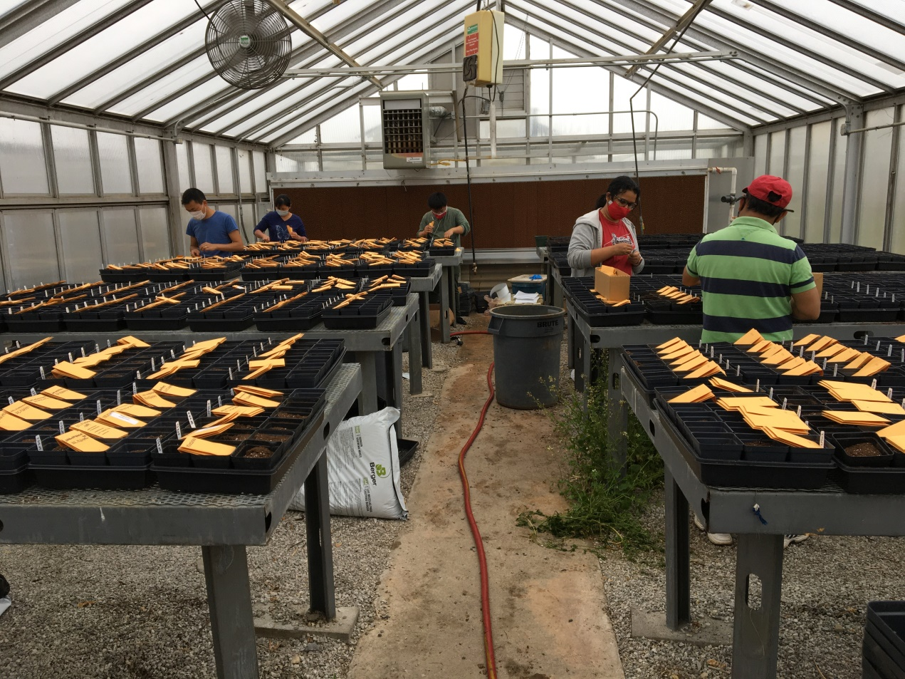
USDA germplasm planting in Pythium infested soil

Slide 7

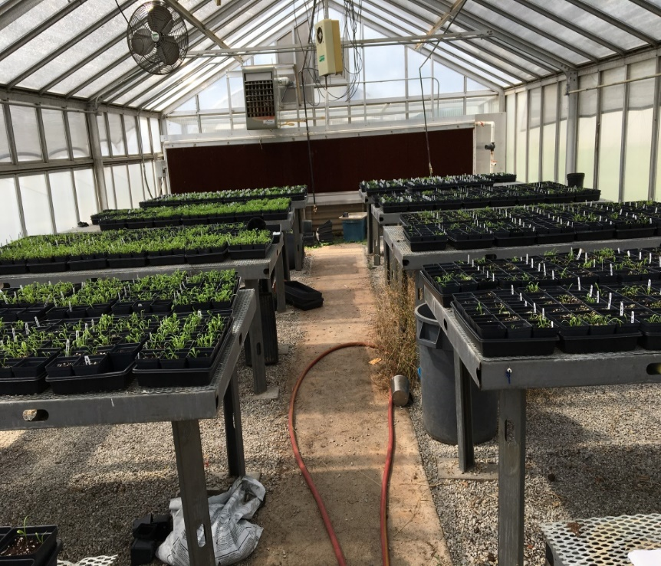
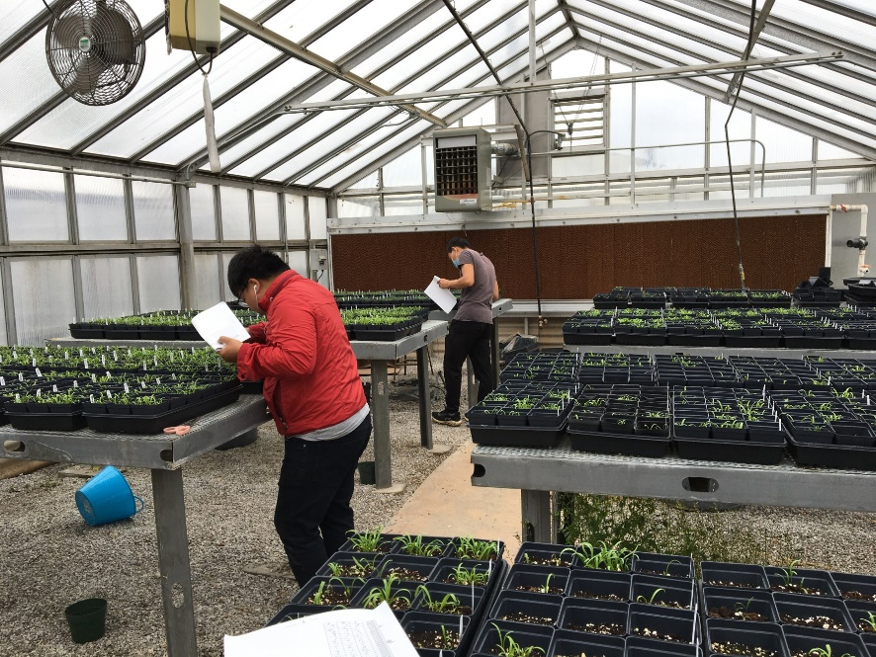
Screening of Pythium
(Count germination rate)
9 days after planting

Slide 8
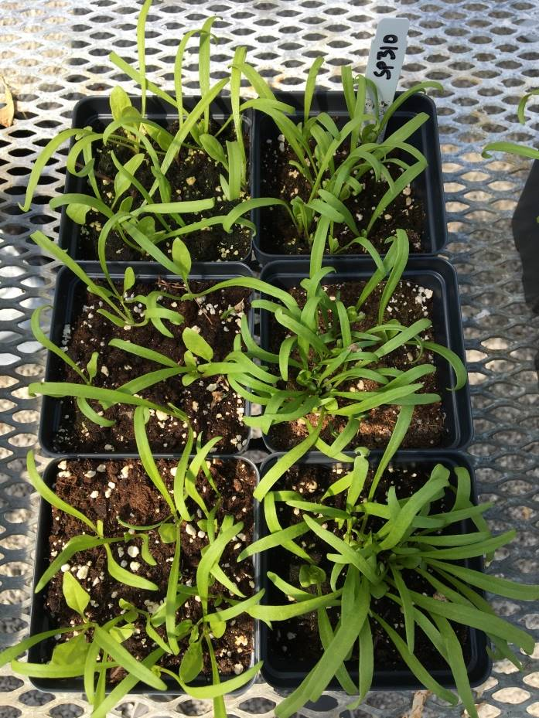
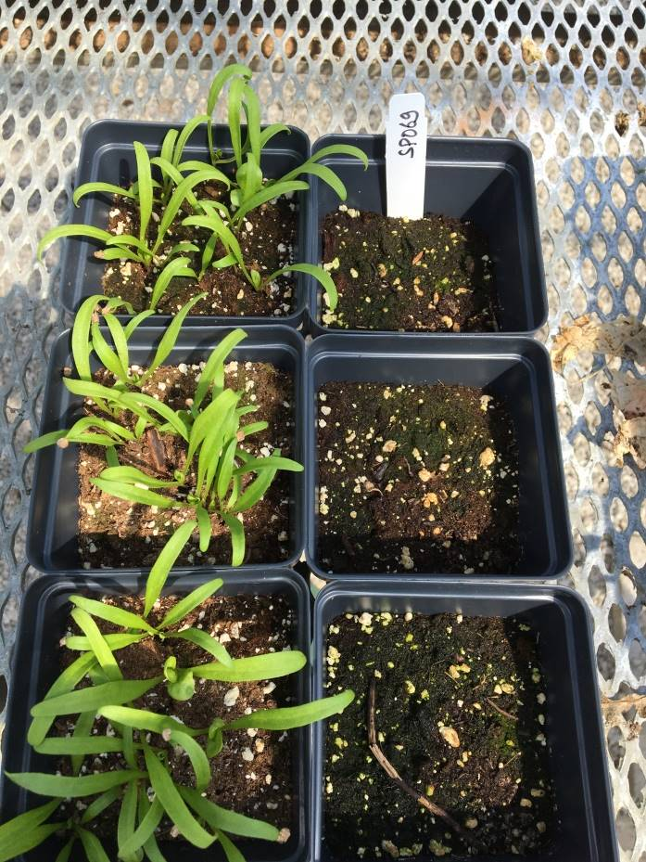
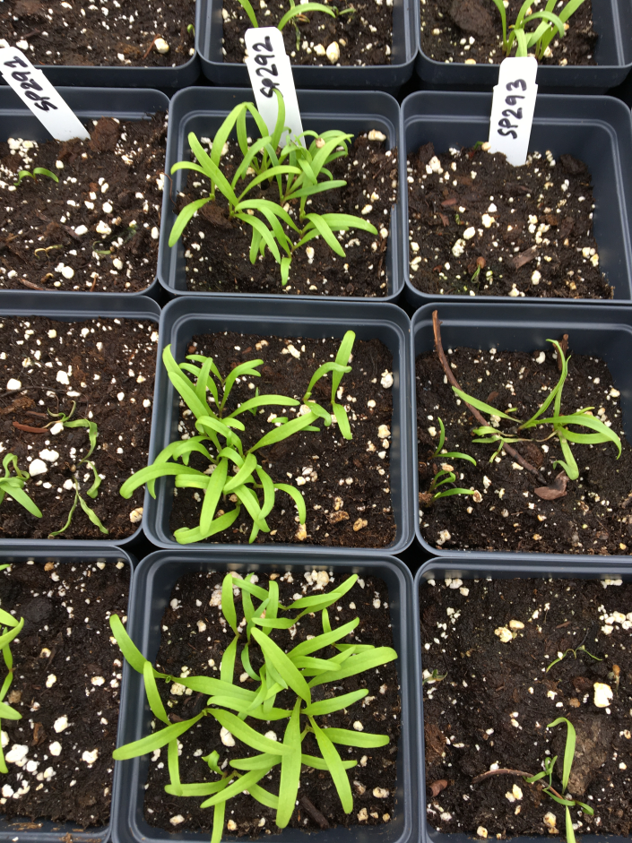
USDA germplasm screening to Pythium

Slide 9
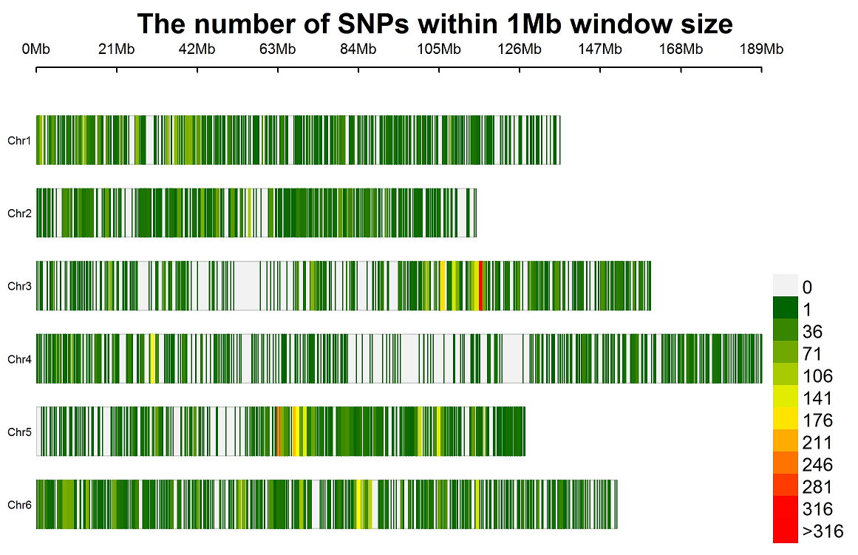
Materials and Methods
Genotyping
Sequencing: using whole genome resequencing (WGR) by Illumina HiSeq platform at BGI.
SNP discovery: 10Gb from WGR were obtained in each spinach line; >10 million SNPs have been found through WGR in spinach
SNP set: 14,286 SNPs distributed on 6 chromosomes were used to perform GWAS after filtered and keeping MAF>5%, Missing < 8%, and Het < 15%
SNP Distribution on Six Chromosomes

Slide 10
Materials & Methods
Genome-wide Association Study
and Genomic Prediction
GWAS:
GLM and MLM in TASSEL 5 (Bradbury et al., 2007)
BLINK, FarmCPU, GLM, MLM, and MLMM in GAPIT 3 (Huang & Zheng 2018)
GP:
rr-BLUP (Endelman 2011)
gBLUP and cBLUP in GAPIT 3 (Wang and Zhang, 2021)
Bayes A (BA), Bayes B (BB), Bayes LASSO (BL), and Bayes ridge regression (BRR) implemented in BGLR package (Legarra et al., 2011; Barili et al., 2018).
5-fold cross-validation sets (training: testing = 4:1) were used to estimate prediction accuracy, with r-value calculated over 100 runs

Slide 11
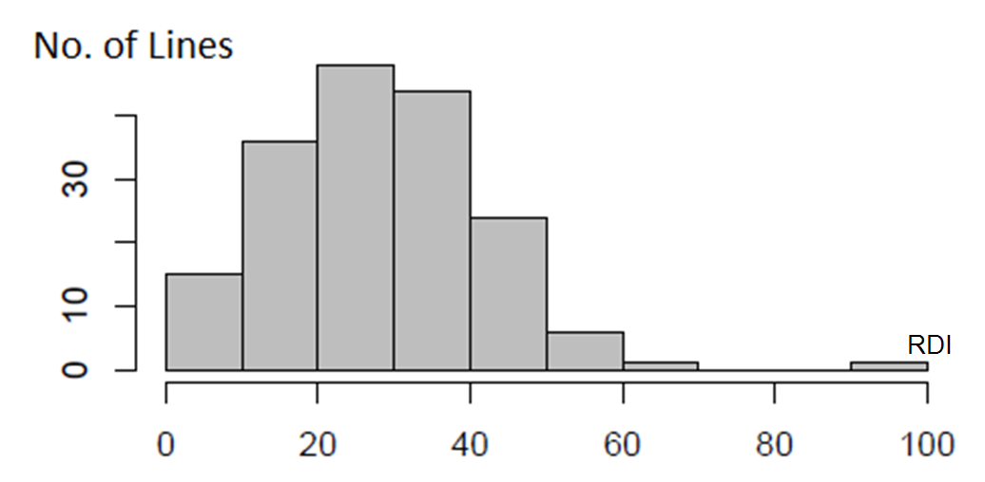
RESULTS
Distribution of RDI (relative disease index) of Pythium aphanidermatum Yuma isolate in 377 USDA spinach germplasm accessions.

Slide 12
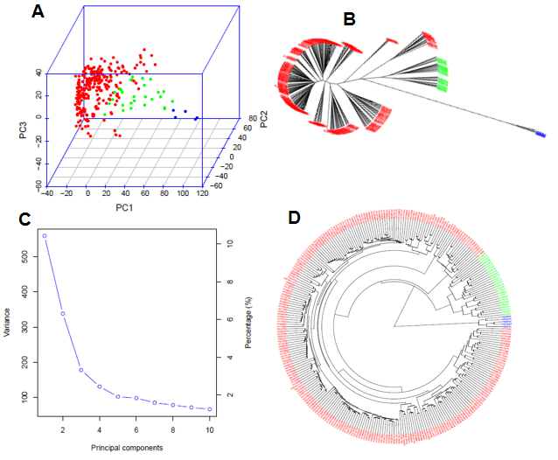
Result
Genetic Diversity and Population Structure
Three subpopulations divided
Population genetic diversity analysis in the association panel consisted of 377 USDA spinach germplasm accessions.
(A) 3D graphical plot of the principal component analysis (PCA),
(B & D) Phylogenetic trees (B – unrooted and D - fan) drawn by neighbor-joining (NJ) method in three sub-population, and (C) PCA.eigenValue plot drawn by GAPIT 3.

Slide 13
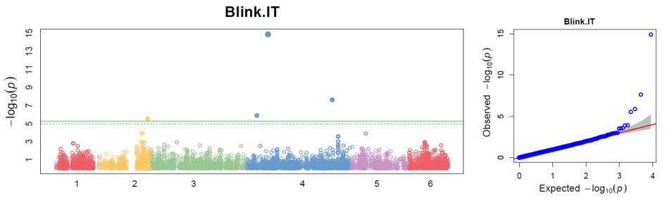
Result
GWAS for Pythium Tolerance
Distribution of Manhattan plot (left) and QQ-plot (right) of GWAS for Pythium aphanidermatum Yuma isolate resistance based on BLINK in GAPIT3. For the Manhattan plot, the x-axis presents the spinach six chromosomes and the y-axis for the LOD (-log(P-value)) value. For the QQ-plot, the x-axis presents LOD (-log(P-value)) value and y-axis for expected LOD (-log(P-value)) value.

Slide 14
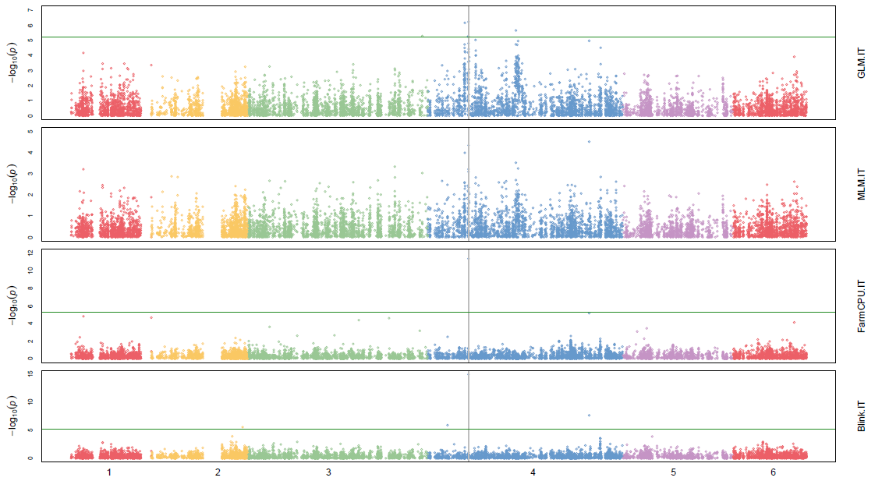
Result
GWAS for Pythium Tolerance

Slide 15
SNP markers associated with Pythium tolerance in germination stage in USDA spinach germplasm
Marker | Chr | Pos | smr_lod | glm_lod | mlm_lod | smr_Rsq | glm_Rsq | mlm_R2
SOVchr4_12308564 | 4 | 12308564 | 4.86 | 4.23 | 3.03 | 0.10541 | 0.08882 | 0.06745
SOVchr4_16871550 | 4 | 16871550 | 5.37 | 5.13 | 3.28 | 0.13603 | 0.12752 | 0.09392
SOVchr4_18747239 | 4 | 18747239 | 5.21 | 4.59 | 3.01 | 0.13245 | 0.11507 | 0.08578
SOVchr4_35642311 | 4 | 35642311 | 5.34 | 6.17 | 3.26 | 0.15067 | 0.16651 | 0.10934
SOVchr4_40981648 | 4 | 40981648 | 5.19 | 5.18 | 3.04 | 0.13178 | 0.1288 | 0.08677
SOVchr4_72026967 | 4 | 72026967 | 5.25 | 4.78 | 3.03 | 0.1485 | 0.13406 | 0.10219
SOVchr4_76417156 | 4 | 76417156 | 4.85 | 5.01 | 3.80 | 0.12372 | 0.12482 | 0.10961
SOVchr4_79000524 | 4 | 79000524 | 4.85 | 4.27 | 3.03 | 0.10524 | 0.08987 | 0.06747
SOVchr4_79429716 | 4 | 79429716 | 4.95 | 4.37 | 3.38 | 0.10754 | 0.09204 | 0.07697
SOVchr4_80780759 | 4 | 80780759 | 5.74 | 5.16 | 3.02 | 0.12583 | 0.10988 | 0.08604
SOVchr4_83654042 | 4 | 83654042 | 7.18 | 6.62 | 3.96 | 0.17773 | 0.16128 | 0.11442 | yes
SOVchr4_107735002 | 4 | 107735002 | 5.74 | 5.16 | 3.55 | 0.12583 | 0.10988 | 0.08155
SOVchr4_115424995 | 4 | 115424995 | 4.76 | 5.53 | 3.23 | 0.13675 | 0.15177 | 0.10837
SOVchr4_116234085 | 4 | 116234085 | 7.86 | 7.05 | 3.99 | 0.20888 | 0.18646 | 0.13285 | yes
SOVchr4_128588245 | 4 | 128588245 | 6.05 | 5.07 | 3.06 | 0.15191 | 0.12626 | 0.10308
SOVchr4_142576938 | 4 | 142576938 | 4.99 | 4.71 | 3.06 | 0.14232 | 0.13255 | 0.103
SOVchr4_146311165 | 4 | 146311165 | 4.59 | 5.23 | 4.29 | 0.13253 | 0.14471 | 0.14255
SOVchr4_154666754 | 4 | 154666754 | 6.41 | 5.68 | 3.88 | 0.14091 | 0.12173 | 0.09093 | y
SOVchr4_154725557 | 4 | 154725557 | 5.19 | 4.16 | 3.01 | 0.11317 | 0.08728 | 0.06672
SOVchr4_154820300 | 4 | 154820300 | 5.09 | 4.07 | 3.17 | 0.11092 | 0.08525 | 0.0712
SOVchr4_165369092 | 4 | 165369092 | 5.74 | 4.98 | 3.15 | 0.14481 | 0.12417 | 0.09001
SOVchr4_167626850 | 4 | 167626850 | 6.62 | 5.55 | 3.31 | 0.16514 | 0.13724 | 0.09462
SOVchr4_167708884 | 4 | 167708884 | 5.30 | 4.19 | 3.00 | 0.11567 | 0.08803 | 0.0667
SOVchr4_168197798 | 4 | 168197798 | 4.98 | 4.83 | 3.21 | 0.12691 | 0.12054 | 0.09164
SOVchr4_170976585 | 4 | 170976585 | 4.27 | 4.06 | 3.13 | 0.12457 | 0.11664 | 0.10515

Slide 16
SUMMARY
Pythium tolerant spinach accessions at germination stage were identified.
GWAS analysis identified SNP markers associated with the resistance to Pythium at germination.
SNP markers associated with Pythium resistance could be useful in molecular breeding efforts upon validation in the future.
R
S

